Slide 1
Session 1: Introduction to R
Dr. Jim Duggan,
School of Engineering & Informatics
National University of Ireland Galway.

Slide 2
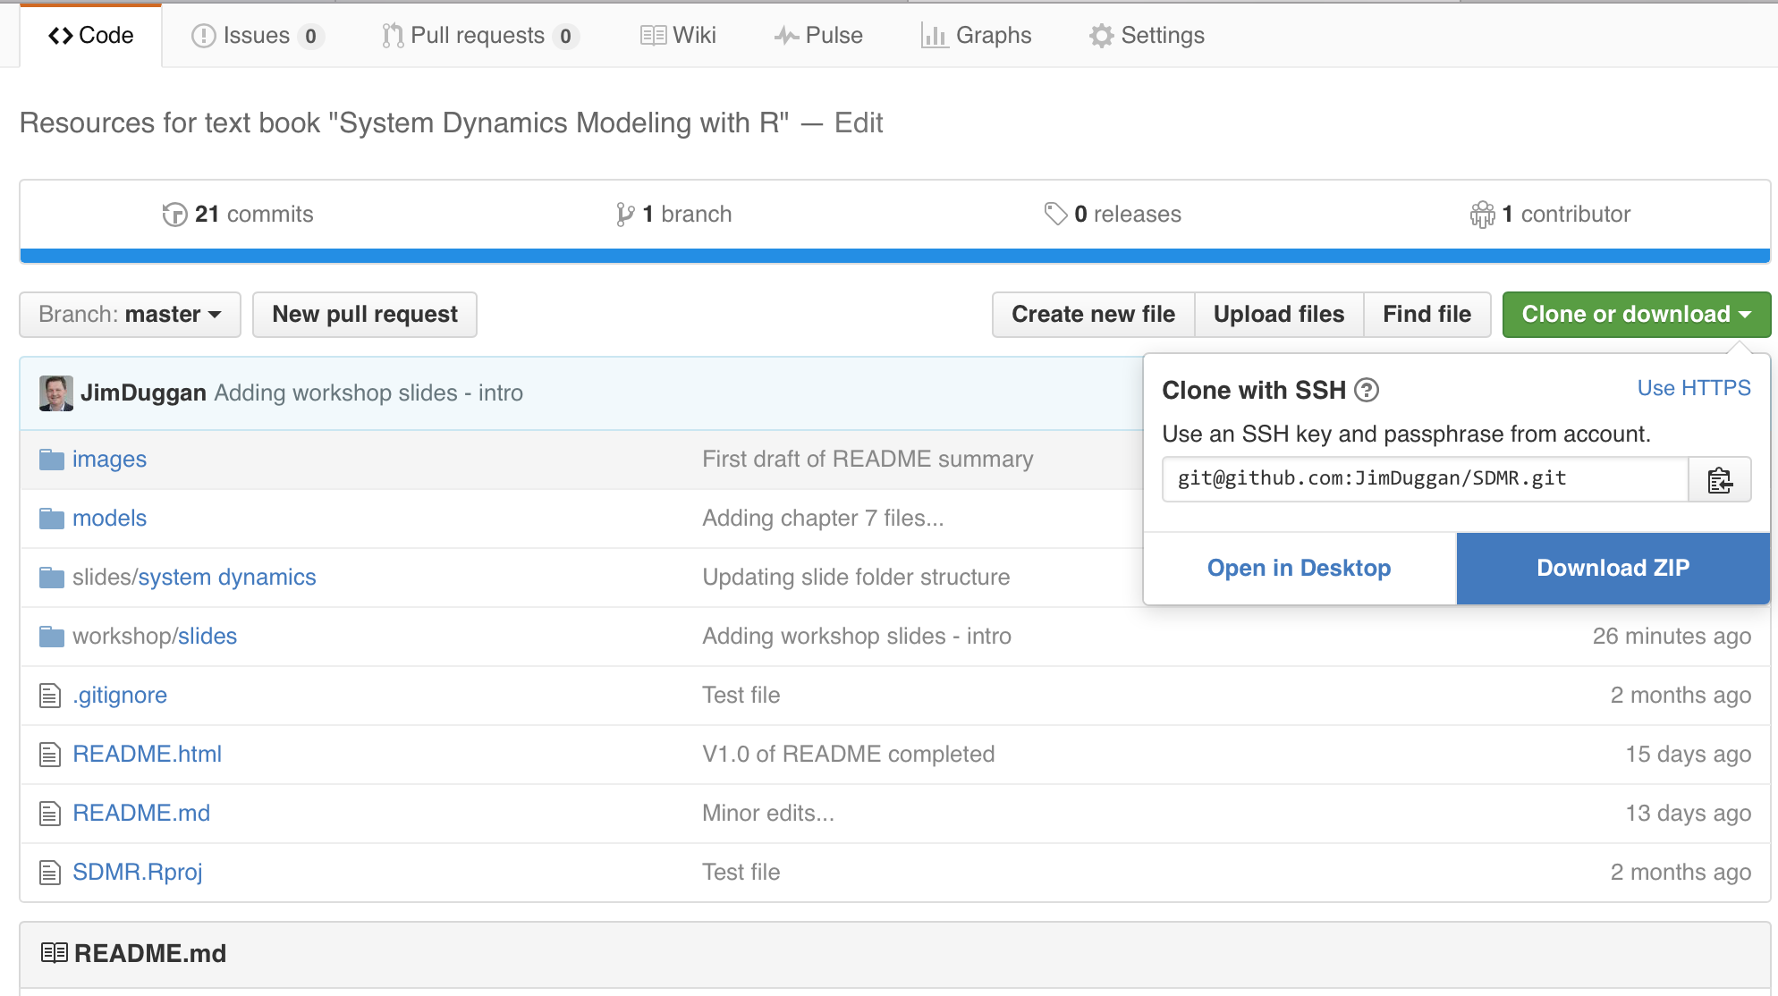
First step… download materials… https://github.com/JimDuggan/SDMR

Slide 3
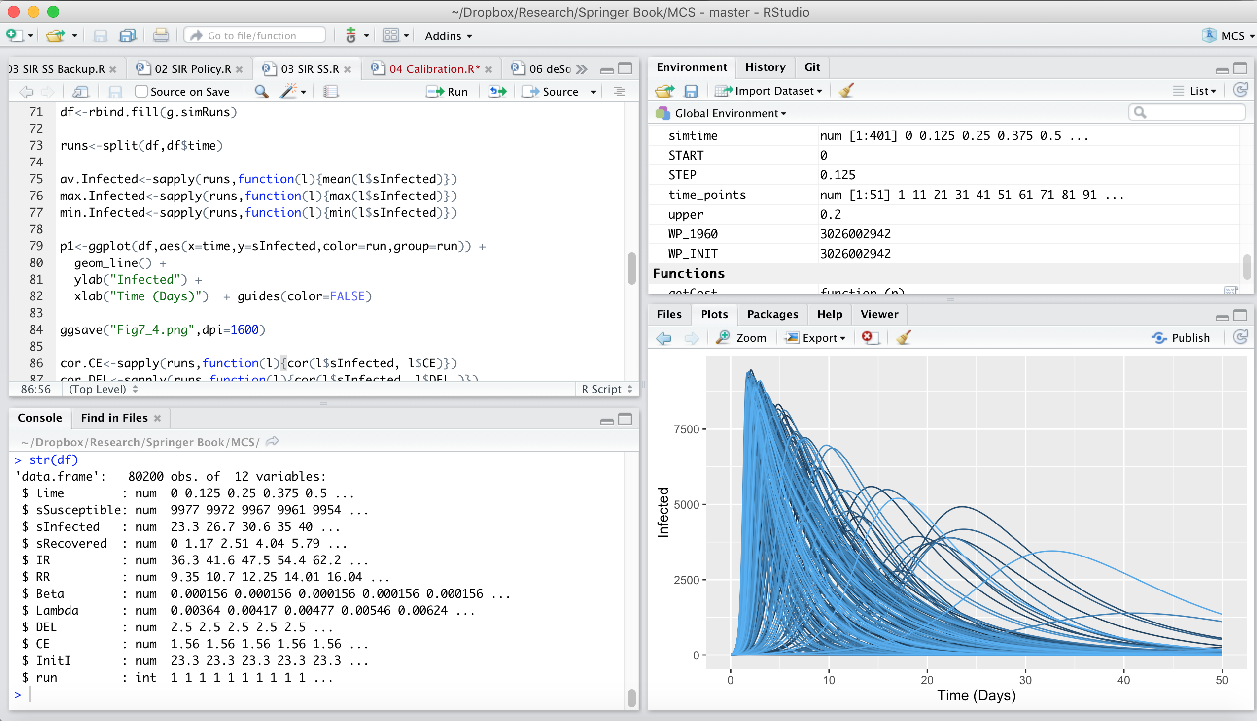
Outline
Introduction to R
Storing data
Vectors
Lists
Matrices
Data Frames
Functions
Visualisation

Slide 4
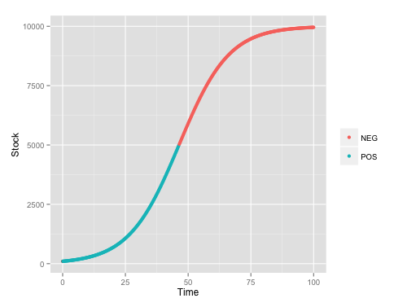
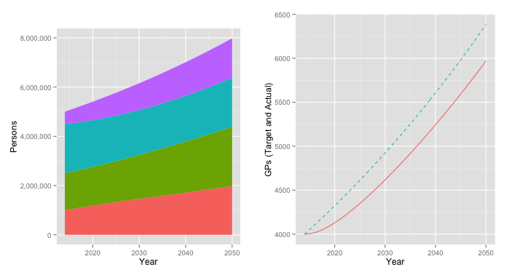
What is R?
It is a dialect of the S language, developed at Bell Laboratories
Open source, functional & object-oriented language
R’s mission is to enable the best and most thorough exploration of data possible (Chambers 2008).

Slide 5
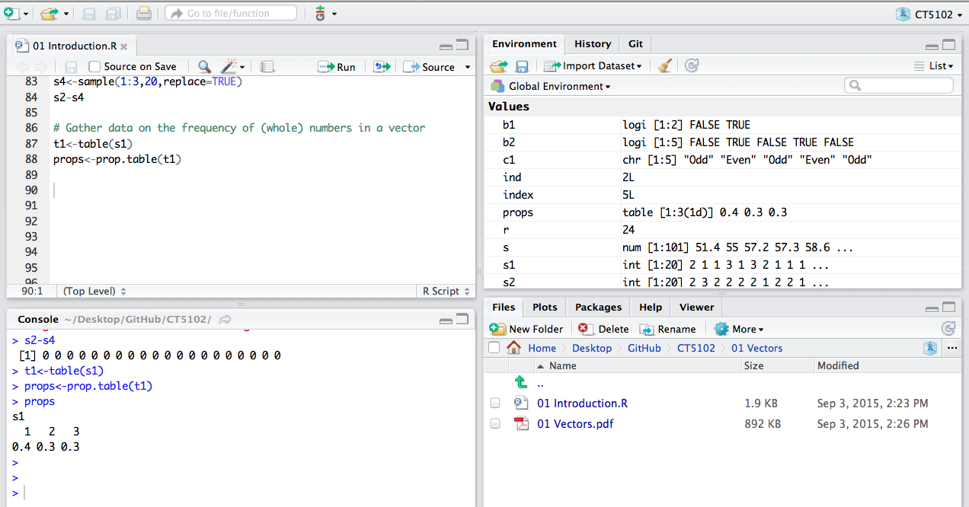
R Studio Workbench
R Code
Environment/State
Interactive console
File System

Slide 6
(1) Data Structures - Vector
v1
The fundamental data type in R is the vector,
A variable that contains a sequence of elements that have the same data type (Matloff 2009).
Create using c(e₁, …, e_{n})
Assignment statement <-
1
4
9
16
25
> v1<-c(1,4,9,16,25)
> v1
[1] 1 4 9 16 25

Slide 7
Four main types of atomic vectors
logical
integer
double
character
> v1<-c(T,FALSE)
> v2<-c(10L,20L)
> v3<-c(3.5,12.2)
> v4<-c("system","dynamics")
>
> typeof(v1)
[1] "logical"
> typeof(v2)
[1] "integer"
> typeof(v3)
[1] "double"
> typeof(v4)
[1] "character")
> v5<-c(v1,v2)
> v5
[1] 1 0 10 20
> typeof(v5)
[1] "integer"

Slide 8
Index
The concept of an index is powerful in R, as it allows access to individual data elements of a vector, using the square brackets notation.
In R, unlike programming languages such as C and Java, the index for a vector starts at 1.
> v1
[1] 1 4 9 16 25
> v1[1]
[1] 1
> v1[2]
[1] 4
> v1[5]
[1] 25

Slide 9
Creating sequences
The colon operator (:) generates regular sequences within a specified range.
> v1<-1:10
> v1
[1] 1 2 3 4 5 6 7 8 9 10
> v2<-3:13
> v2
[1] 3 4 5 6 7 8 9 10 11 12 13

Slide 10
Sequences as indices
Sequences can be used an indices for vectors, with the minus sign used for exclusion
> v1
[1] 1 4 9 16 25
> v1[1:2]
[1] 1 4
> v1[-1]
[1] 4 9 16 25
> v1[-(1:3)]
[1] 16 25

Slide 11
Vectorization
A powerful feature of R is that it supports vectorization
Functions can operate on every element of a vector, and return the results of each individual operation in a new vector.
> v1
[1] 1 2 3 4 5
> r<-sqrt(v1)
> r
[1] 1.000000 1.414214 1.732051 2.000000 2.236068

Slide 12
Key Idea
Input Vector
Output Vector
1
1
4
2
sqrt()
9
3
16
4
25
5

Slide 13
Conditional Expressions on Vectors
Operator Description
< less than
<= less than or equal to
> greater than
>= greater than or equal to
== exactly equal to
!= not equal to
!x Not x
x | y x OR y
x & y x AND y
isTRUE(x) test if X is TRUE
Operators | Description
< | less than
<= | less than or equal to
> | greater than
>= | greater than or equal to
== | exactly equal to
!= | not equal to
!x | not x
x | y | x OR y
x & y | x AND y
Conditional expressions can be applied to vectors, and this operation returns a boolean vector
> v1
[1] 1 4 9 16 25
> v1 %% 2==0
[1] FALSE TRUE FALSE TRUE FALSE
http://www.statmethods.net/management/operators.html

Slide 14
Boolean vectors used as indices
A target the vector can be filtered by the TRUE locations in the boolean vector.
> v1
[1] 1 4 9 16 25
> b1<-v1 %% 2 == 1
> b1
[1] TRUE FALSE TRUE FALSE TRUE
> v1[b1]
[1] 1 9 25

Slide 15


Challenge 1
Create an R vector of squares of 1 to 10
Find the minimum
Find the maximum
Display all those greater than the mean
Display all those less than the mean
Display every second vector element
Find the index location of the maximum value

Slide 16
(2) Functions
A function is a group of instructions that:
takes input,
uses the input to compute other value, and
returns a result.
Functions are declared:
using the function reserved word
are objects
function(arguments){
expression
}

Slide 17
Example
simtime()
simtime<-function(start, finish, DT=1){
seq(start,finish,by = DT)
}
> simtime(1,10,0.25)
[1] 1.00 1.25 1.50 1.75 2.00 2.25 2.50 2.75 3.00 3.25 3.50 3.75 4.00
[14] 4.25 4.50 4.75 5.00 5.25 5.50 5.75 6.00 6.25 6.50 6.75 7.00 7.25
[27] 7.50 7.75 8.00 8.25 8.50 8.75 9.00 9.25 9.50 9.75 10.00

Slide 18
Challenge 2
Write a function that takes in a vector and returns the number of odd numbers
Write a function that takes in a vector and returns a vector of even numbers
Write a function that returns the unique values in a vector (hint: use the R function duplicated)

